Slide 1
Default text (Verdana 24 pt)
Variation
Default shape
Dark blue outline, 3 pt weight
Light blue fill
Black text, centered
Verdana 24 pt
Variation
Variation
(not exhaustive)

Slide 2
In this lesson you are going to learn to solve two digit by two digit multiplication problems by using the area model.

Slide 3
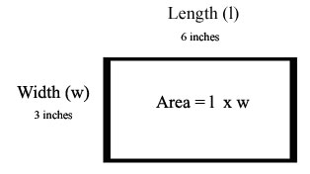

Slide 4
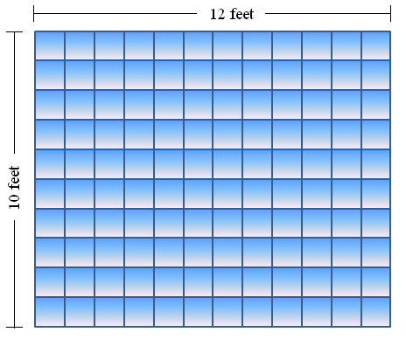

Slide 5
Solve the problem 11 x 23 using the area model.

Slide 6
Solve the problem 11 x 23 using the area model.

Slide 7
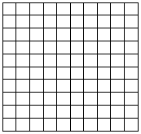
Solve the problem 11 x 23 using the area model.

Slide 8
Solve the problem 11 x 23 using the area model.

Slide 9
Solve the problem 11 x 23 using the area model.

Slide 10
Solve the problem 11 x 23 using the area model.

Slide 11
Solve the problem 11 x 23 using the area model.

Slide 12
In this lesson you learned to solve two digit by two digit multiplication problems by using the area model.

